Slide 1
Unit 6 Data Warehousing

Slide 2
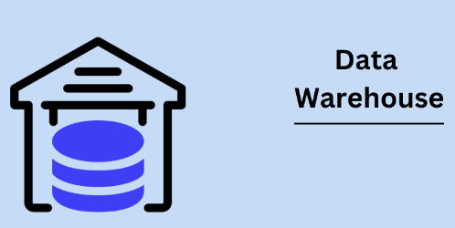
Data Warehousing
A Data Warehousing (DW) is process for collecting and managing data from varied sources to provide meaningful business insights.
A Data Warehouse is a collection of software tools that facilitates analysis of a large set of business data used to help an organization make decisions.
A data warehouse is mainly a data management system that’s designed to enable and support business intelligence (BI) activities, particularly analytics. Data warehouses are alleged to perform queries, cleaning, manipulating, transforming and analyzing the data.
A large amount of data in data warehouses comes from numerous sources such that internal applications like marketing, sales, and finance; customer-facing apps
Notes:
A data-warehouse is a heterogeneous collection of different data sources organised under a unified schema. It can be loosely described as any centralized data repository which can be queried for business benefits. It is a database that stores information oriented to satisfy decision-making requests.
It is a blend of technologies and components which aids the strategic use of data.

Slide 3
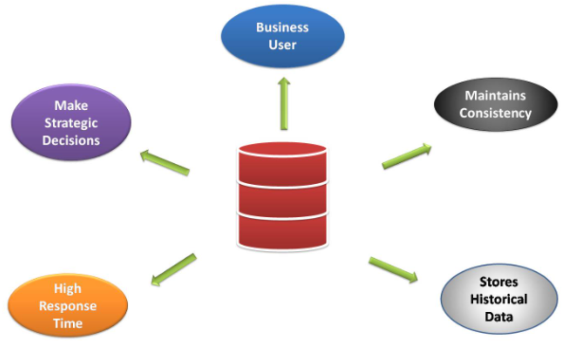
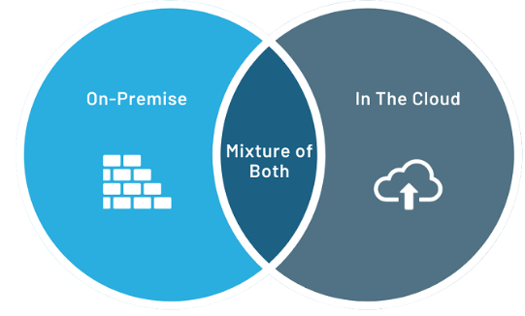
Why You Need a Data Warehouse?
During the early days, you may be using your regular database to run SQL queries for analytics. But, with the increase in the size of the data and individuals using the data to perform various analysis, your regular database becomes extremely slow in query processing.
This is where companies understood the need for Data Warehouse that on the other hand, is designed to handle huge volumes of data. It allows you to swiftly Filter, Sort, Aggregate, and Analyze the data.
It allows organizations to make quality business decisions. The data warehouse benefits by improving data analytics, it also helps to gain considerable revenue and the strength to compete more strategically in the market.
A data warehouse can be stored on-premise, in the cloud, or a mixture of the two environments.
Notes:
Data warehouses can be stored on-premise, in the cloud, or a mixture of the two environments. Your decision may depend on requirements to keep organization-mission critical applications on-premise. If you are looking into cloud solutions, take into consideration industrial regulations, security, visibility, accessibility, latency, and trustworthiness of the cloud providers. (Some top cloud providers include Amazon Web Services (AWS), Google Cloud Platform (GCP), and Microsoft Azure

Slide 4
Database System | Data Warehouse
It supports operational processes. | It supports analysis and performance reporting.
Capture and maintain the data. | Explore the data.
Current data. | Multiple years of history.
Data is balanced within the scope of this one system. | Data must be integrated and balanced from multiple system.
Data is updated when transaction occurs. | Data is updated on scheduled processes.
Varies from about 100 MB to GB. | Varies from about 100 GB to TB.

Slide 5
Benefits of a Data Warehouse
Improved business intelligence: When you integrate multiple sources, you make decisions based on ALL your data.
Timely access to data: Quickly access critical data in one centralized location.
Enhanced data quality and consistency: Data throughout the organization is standardized and stored in the same format so all departments are making decisions based on uniform data.
Historical intelligence: Because a data warehouse stores large amounts of historical data, you can identify trends through year-over-year and month-over-month analysis.
Quick query response times: Most data warehouses are modeled, built, and optimized for read access, and that means fast report generation.
Data mining: Explore “Big Data” to predict future trends.
Centralized business logic: Storing business logic in the data warehouse minimizes the chances of having multiple versions of the truth.

Slide 6
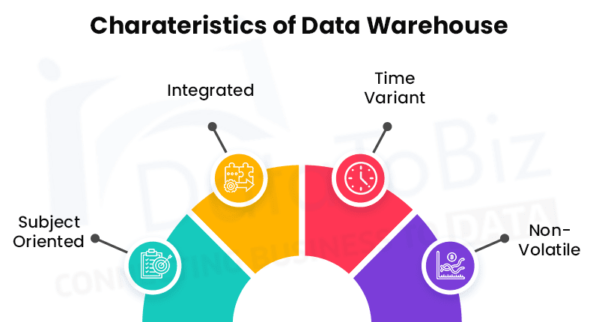
Characteristics of data warehousing
Subject-Oriented
A data warehouse target on the modeling and analysis of data for decision-makers. Therefore, data warehouses typically provide a concise and straightforward view around a particular subject, such as customer, product, or sales, instead of the global organization's ongoing operations.
Integrated
In Data Warehouse, integration means the establishment of a common unit of measure for all similar data from the dissimilar database
Time-Variant
It contains an element of time, explicitly or implicitly.
Non-volatile
Also, the data warehouse is non-volatile, meaning that prior data will not be erased when new data are entered into it

Slide 7
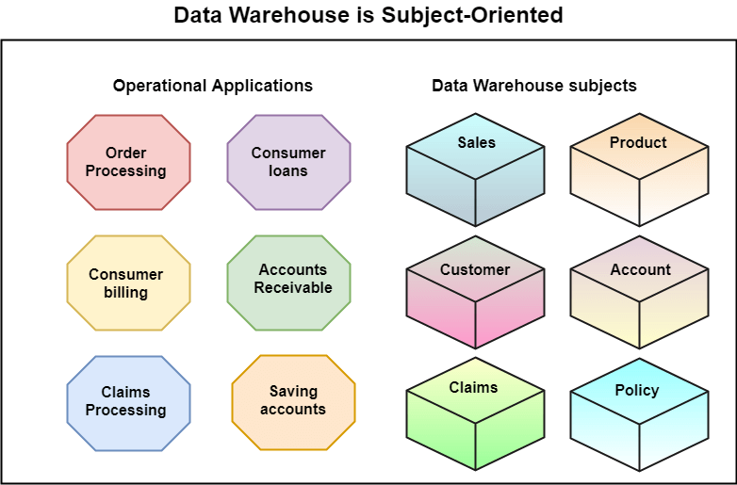
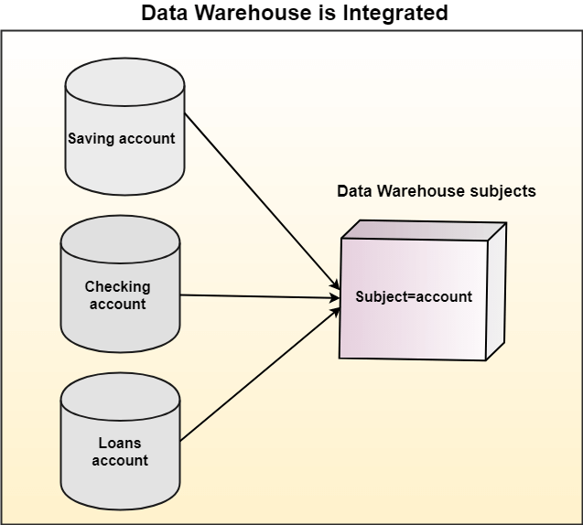
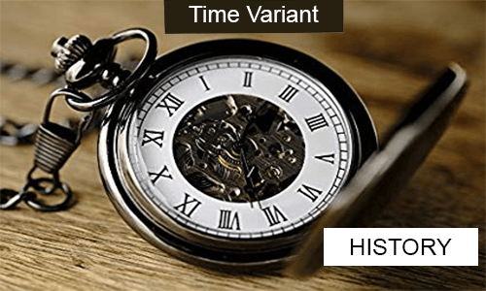
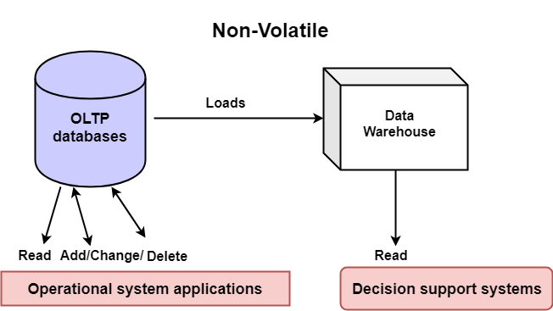
Characteristics of data warehousing

Slide 8
Example Applications of Data Warehousing
Data Warehousing can be applied anywhere where we have a huge amount of data and we want to see statistical results that help in decision making.
Social Media Websites: The social networking websites like Facebook, Twitter, Linkedin, etc. are based on analyzing large data sets. These sites gather data related to members, groups, locations, etc., and store it in a single central repository. Being a large amount of data, Data Warehouse is needed for implementing the same.
Banking: Most of the banks these days use warehouses to see the spending patterns of account/cardholders. They use this to provide them with special offers, deals, etc.
Government: Government uses a data warehouse to store and analyze tax payments which are used to detect tax thefts.
Notes:
Examples:Snowflake. Snowflake is one of the most popular and easy-to-use data warehouses out there. ...
Google BigQuery. ...
Amazon Redshift. ...
Azure Synapse Analytics. ...
IBM Db2 Warehouse. ...
Firebolt.

Slide 9
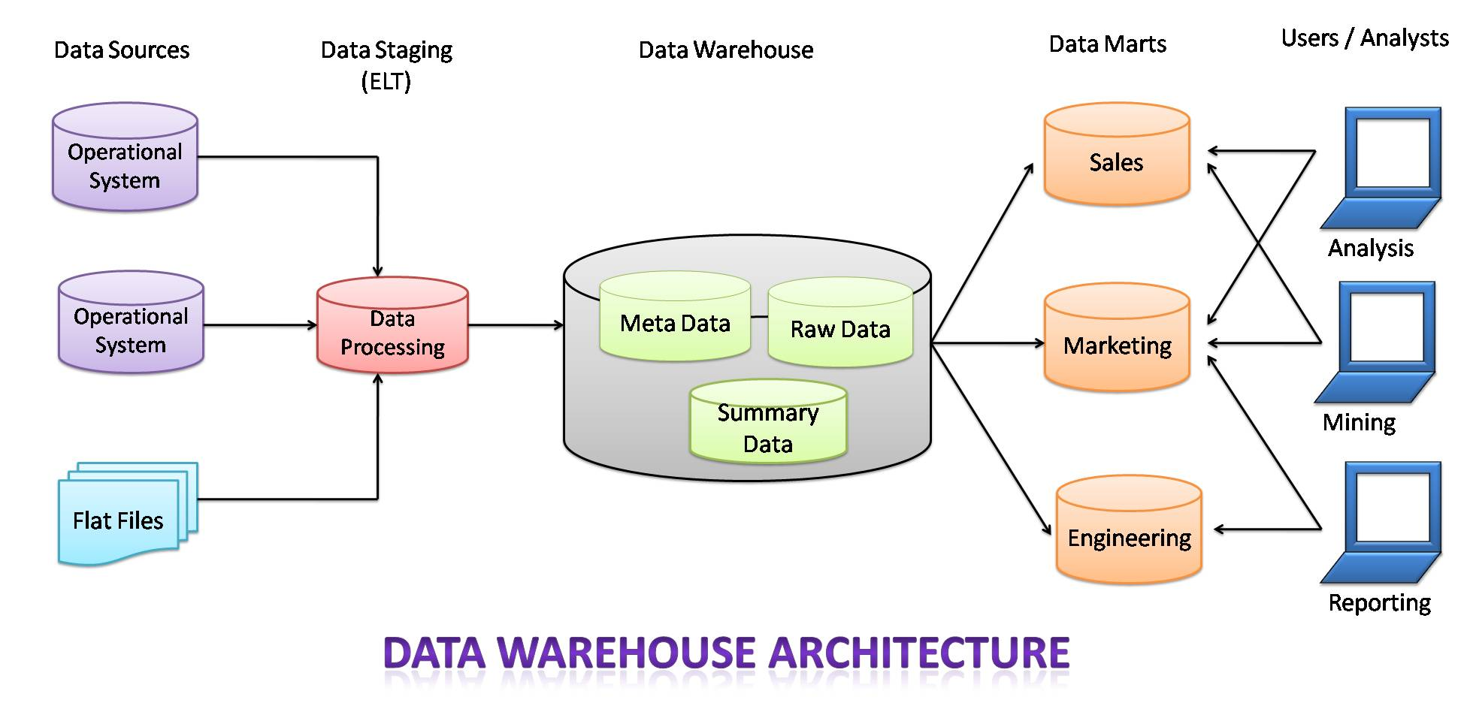
Architecture & Components of Data Warehouse
The architecture of the data warehouse mainly consists of the proper arrangement of its elements, to build an efficient data warehouse with software and hardware components. The elements and components may vary based on the requirement of organizations. All of these depend on the organization’s circumstances.

Slide 10
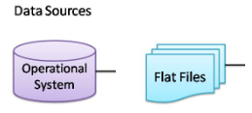
Architecture & Components of Data Warehouse
1. Source Data Component:
In the Data Warehouse, the source data comes from different places. They are group into four categories:
External Data: For data gathering, most of the executives and data analysts rely on information coming from external sources for a numerous amount of the information they use. They use statistical features associated with their organization that is brought out by some external sources and department.
Internal Data: In every organization, the consumer keeps their “private” spreadsheets, reports, client profiles, and generally even department databases.
Operational System data: Operational systems are principally meant to run the business. In each operation system, we periodically take the old data and store it in achieved files.
Flat files: A flat file is nothing but a text database that stores data in a plain text format. Flat files generally are text files that have all data processing and structure markup removed. A flat file contains a table with a single record per line.

Slide 11
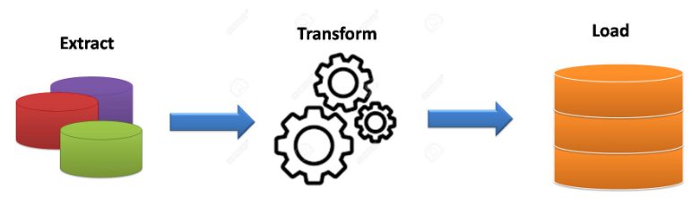
Architecture & Components of Data Warehouse
2. Data Staging: After the data is extracted from various sources, now it’s time to prepare the data files for storing in the data warehouse. The extracted data collected from various sources must be transformed and made ready in a format that is suitable to be saved in the data warehouse for querying and analysis.
Data Extraction: This stage handles various data sources. Data analysts should employ suitable techniques for every data source.
Data Transformation: We tend to perform many individual tasks as a part of information transformation. First, we tend to clean the info extracted from every source of data. Once the data transformation performs ends, we’ve got a set of integrated information that’s clean, standardized, and summarized.
Data Loading: When we complete the structure and construction of the data warehouse we do the initial loading of the data into the data warehouse storage.
Notes:
ETL tool. E(Extracted): Data is extracted from External data source.
T(Transform): Data is transformed into the standard format.
L(Load): Data is loaded into datawarehouse after transforming it into the standard format.

Slide 12
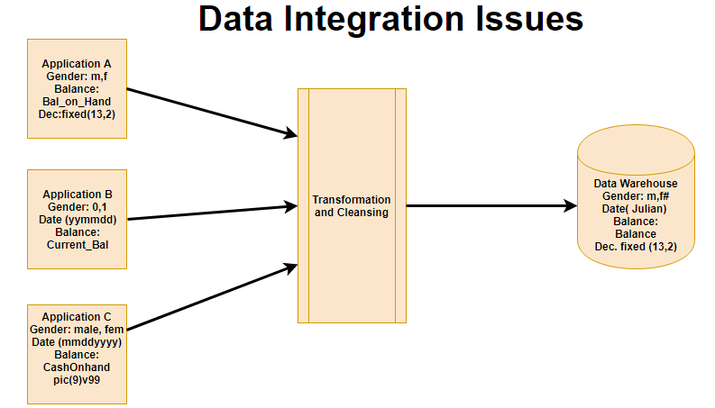
In this example, there are three different application labeled A, B and C. Information stored in these applications are Gender, Date, and Balance. However, each application’s data is stored different way.
In Application A gender field store logical values like M or F
In Application B gender field is a numerical value,
In Application C application, gender field stored in the form of a character value.
Same is the case with Date and balance

Slide 13
To integrate heterogeneous databases, we have two approaches −
Query-driven Approach
Update-driven Approach
Query-Driven Approach
This is the traditional approach to integrate heterogeneous databases. This approach was used to build wrappers and integrators on top of multiple heterogeneous databases. These integrators are also known as mediators.
Process of Query-Driven Approach
When a query is issued to a client side, a metadata dictionary translates the query into an appropriate form for individual heterogeneous sites involved.
Now these queries are mapped and sent to the local query processor.
The results from heterogeneous sites are integrated into a global answer set.
Disadvantages
Query-driven approach needs complex integration and filtering processes.
This approach is very inefficient.
It is very expensive for frequent queries and for queries that require aggregations
Update-Driven Approach
This is an alternative to the traditional approach. Today's data warehouse systems follow update-driven approach rather than the traditional approach discussed earlier. In update-driven approach, the information from multiple heterogeneous sources are integrated in advance and are stored in a warehouse. This information is available for direct querying and analysis.

Slide 14
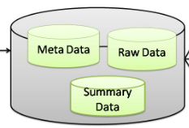
Architecture & Components of Data Warehouse
3. Data Storage in Warehouse: Data storage for data warehousing is split into multiple repositories.
These data repositories contain structured data in a very highly normalized form for fast and efficient processing.
Metadata: Metadata means data about data i.e. it summarizes basic details regarding data, creating findings & operating with explicit instances of data.
Raw Data: Raw data is a set of data and information that has not yet been processed and was delivered from a particular data entity to the data supplier and hasn’t been processed by machine or human.
Summary Data or Data summary: Data summary is an easy term for a brief conclusion of an enormous theory or a paragraph. This is often one thing where analysts write the code and in the end, they declare the ultimate end in the form of summarizing data.

Slide 15
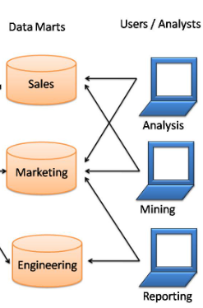
Architecture & Components of Data Warehouse
4. Data Marts:
It can store the information of a specific function of an organization that is handled by a single authority.
We can also say that data mart contains subset of the data stored in data warehouse.
There may be any number of data marts in a particular organization depending upon the functions. In short, data marts contain subsets of the data stored in data warehouses.
5. Users/Analysts
Now, the users and analysts can use data for various applications like reporting, analyzing, mining, etc. The data is made available to them whenever required.
Notes:
Data marts contain a subset of organization-wide data that is valuable to specific groups of people in an organization. In other words, a data mart contains only those data that is specific to a particular group. For example, the marketing data mart may contain only data related to items, customers, and sales. Data marts are confined to subjects.

Slide 16
Online Analytical Processing (OLAP)
OLAP stands for On-Line Analytical Processing. OLAP is a classification of software technology which authorizes analysts, managers, and executives to gain insight into information through fast, consistent, interactive access in a wide variety of possible views of data that has been transformed from raw information to reflect the real dimensionality of the enterprise as understood by the clients.
OLAP implement the multidimensional analysis of business information and support the capability for complex estimations, trend analysis, and sophisticated data modeling.
It is rapidly enhancing the essential foundation for Intelligent Solutions containing Business Performance Management, Planning, Budgeting, Forecasting, Financial Documenting, Analysis, Simulation-Models, Knowledge Discovery, and Data Warehouses Reporting.
Notes:
OLAP was introduced by E.F.Codd and it is a category of software technology that enables analysts, manager to analyze the complex data derived from the datawarehouse and get meaningful insight from that data by representing it in multidimensional facets. Examples – Any type of Data warehouse system is an OLAP system. The uses of OLAP are as follows:
Spotify analyzed songs by users to come up with a personalized homepage of their songs and playlist.
Netflix movie recommendation system.

Slide 17
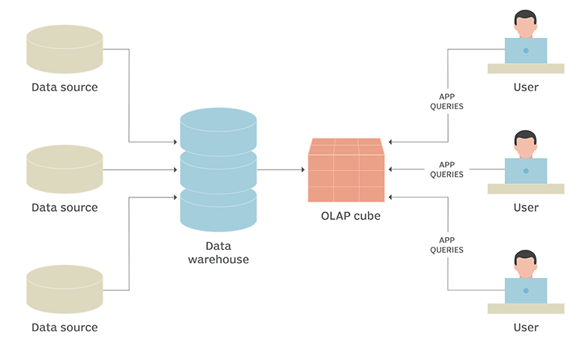
Online Analytical Processing (OLAP)
How OLAP systems work
To facilitate this kind of analysis, data is collected from multiple data sources and stored in data warehouses then cleansed and organized into data cubes.
Each OLAP cube contains data categorized by dimensions (such as customers, geographic sales region and time period) derived by dimensional tables in the data warehouses.
Dimensions are then populated by members (such as customer names, countries and months) that are organized hierarchically.
OLAP cubes are often pre-summarized across dimensions to drastically improve query time over relational databases.
A data cube is a multi-dimensional array of values used to bring together data to be organized and modeled for analysis.

Slide 18
Online Analytical Processing (OLAP)-Operations
Analysts can then perform five types of OLAP analytical operations against multidimensional databases:
Roll-up. Also known as consolidation, this operation summarizes the data along the dimension.
Drill-down. This allows analysts to navigate deeper among the dimensions of data, for example drilling down from "time period" to "years" and "months" to chart sales growth for a product.
Slice. This enables an analyst to take one level of information for display, such as "sales in 2017."
Dice. This allows an analyst to select data from multiple dimensions to analyze, such as "sales of blue beach balls in Iowa in 2017."
Pivot. Analysts can gain a new view of data by rotating the data axes of the cube.

Slide 19
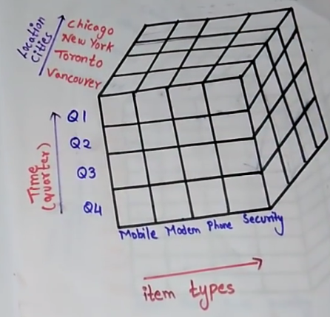
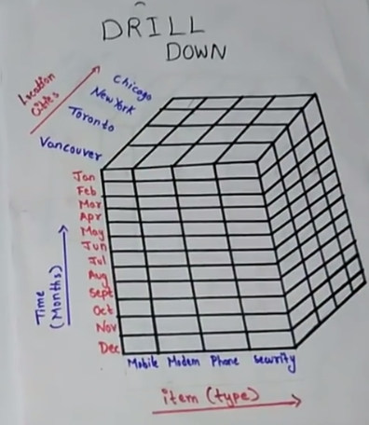
OLAP Operations example

Slide 20
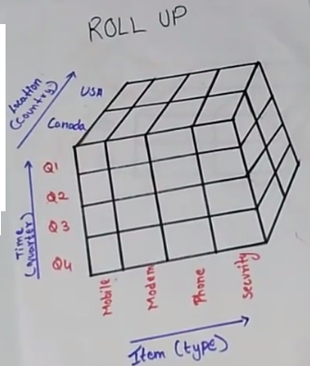
OLAP Operations example

Slide 21
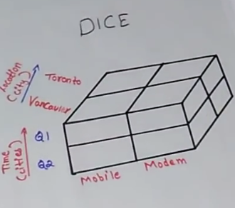
OLAP Operations example

Slide 22
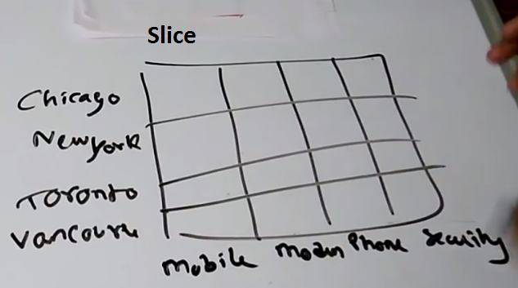
OLAP Operations example

Slide 23
Online Analytical Processing (OLAP)
Analysts can then perform five types of OLAP analytical operations against multidimensional databases:
Roll-up. Also known as aggregation operation or drill-up, this operation summarizes the data along the dimension.
Temperature | 64 | 65 | 68 | 69 | 70 | 71 | 72 | 75 | 80 | 81 | 83 | 85
Week1 | 1 | 0 | 1 | 0 | 1 | 0 | 0 | 0 | 0 | 0 | 1 | 0
Week2 | 0 | 0 | 0 | 1 | 0 | 0 | 1 | 2 | 0 | 1 | 0 | 0
Temperature | cool | mild | hot
Week1 | 2 | 1 | 1
Week2 | 2 | 1 | 1
Consider that we want to set up levels (hot (80-85), mild (70-75), cool (64-69)) in temperature from the above cubes.
To do this, we have to group column and add up the value according to the concept hierarchies.
This operation is known as a roll-up.

Slide 24
Online Analytical Processing (OLAP)
Temperature | cool | mild | hot
Day 1 | 0 | 0 | 0
Day 2 | 0 | 0 | 0
Day 3 | 0 | 0 | 1
Day 4 | 0 | 1 | 0
Day 5 | 1 | 0 | 0
Day 6 | 0 | 0 | 0
Day 7 | 1 | 0 | 0
Day 8 | 0 | 0 | 0
Day 9 | 1 | 0 | 0
Day 10 | 0 | 1 | 0
Day 11 | 0 | 1 | 0
Day 12 | 0 | 1 | 0
Day 13 | 0 | 0 | 1
Day 14 | 0 | 0 | 0
Drill-down. This allows analysts to navigate deeper among the dimensions of data, for example drilling down from "time period" to "years" and "months" to chart sales growth for a product.

Slide 25
Online Analytical Processing (OLAP)
Dice. This allows an analyst to select data from multiple dimensions to analyze.
The dice operation describes a subcube by operating a selection on two or more dimension.
For example, Implement the selection (time = day 3 OR time = day 4) AND (temperature = cool OR temperature = hot) to the original cubes we get the following subcube (still two-dimensional)
Slice. This enables an analyst to take one level of information for display, such as "sales in 2017.“
For example, if we make the selection, temperature=cool we will obtain the following cube:
Temperature | cool
Day 1 | 0
Day 2 | 0
Day 3 | 0
Day 4 | 0
Day 5 | 1
Day 6 | 1
Day 7 | 1
Day 8 | 1
Day 9 | 1
Day 11 | 0
Day 12 | 0
Day 13 | 0
Day 14 | 0
Temperature | cool | hot
Day 3 | 0 | 1
Day 4 | 0 | 0

Slide 26
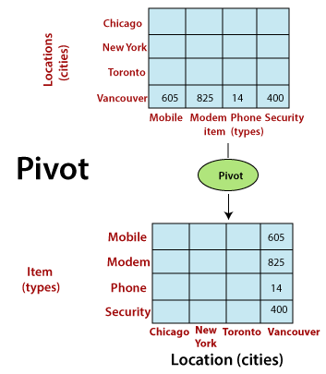
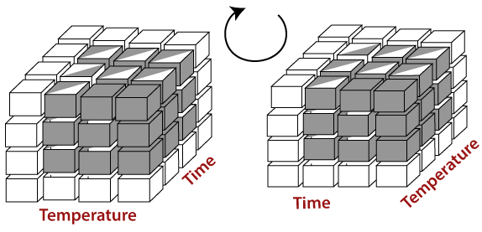
Online Analytical Processing (OLAP)
Pivot. Analysts can gain a new view of data by rotating the data axes of the cube.
It may contain swapping the rows and columns or moving one of the row-dimensions into the column dimensions.

Slide 27
Types of OLAP- ROLAP
There are three main types of OLAP servers are as following:
ROLAP stands for Relational OLAP, an application based on relational DBMSs.
ROLAP can handle large amounts of data.
The ROLAP is based on the premise that data need not to be stored multidimensional in order to viewed multidimensional. In ROLAP data is stored in a relational database. In essence, each action of slicing and dicing is equivalent to adding a “WHERE” clause in SQL statement. Thereby resulting in poor query performance.
Require experienced analyst.
Notes:
Can handle large amounts of information: The data size limitation of ROLAP technology is depends on the data size of the underlying RDBMS. So, ROLAP itself does not restrict the data amount.

Slide 28
Types of OLAP- MOLAP
MOLAP stands for Multidimensional OLAP, an application based on multidimensional DBMSs.
Data are stored physically into multidimensional arrays. So supports complex operations.
One of the significant distinctions of MOLAP against a ROLAP is that data are summarized and are stored in an optimized format in a multidimensional cube, instead of in a relational database.
In MOLAP model, data are structured into proprietary formats by client's reporting requirements with the calculations pre-generated on the cubes.
Notes:
Excellent Performance: A MOLAP cube is built for fast information retrieval, and is optimal for slicing and dicing operations.
Can perform complex calculations: All evaluation have been pre-generated when the cube is created. Hence, complex calculations are not only possible, but they return quickly.
Disadvantages
Limited in the amount of information it can handle: Because all calculations are performed when the cube is built, it is not possible to contain a large amount of data in the cube itself.

Slide 29
Types of OLAP- HOLAP
HOLAP stands for Hybrid OLAP, an application using both relational and multidimensional techniques.
HOLAP incorporates the best features of MOLAP and ROLAP into a single architecture. HOLAP systems save more substantial quantities of detailed data in the relational tables while the aggregations are stored in the pre-calculated cubes.
The Microsoft SQL Server 2000 provides a hybrid OLAP server.

Slide 30
OLTP
On-Line Transaction Processing (OLTP) System refers to the system that manage transaction oriented applications. These systems are designed to support on-line transaction and process query quickly on the Internet.
For example: POS (point of sale) system of any supermarket is a OLTP System.
Every industry in today’s world use OLTP system to record their transactional data. The main concern of OLTP systems is to enter, store and retrieve the data. They covers all day to day operations such as purchasing, manufacturing, payroll, accounting, etc.of an organization. Such systems have large numbers of user which conduct short transaction. It supports simple database query so the response time of any user action is very fast.
The data acquired through an OLTP system is stored in commercial RDBMS, which can be used by an OLAP System for data analytics and other business intelligence operations.

Slide 31
Key Difference between OLTP and OLAP
Online Analytical Processing (OLAP) is a category of software tools that analyze data stored in a database, whereas Online transaction processing (OLTP) supports transaction-oriented applications in a 3-tier architecture.
OLAP creates a single platform for all types of business analysis needs which includes planning, budgeting, forecasting, and analysis, while OLTP is useful for administering day-to-day transactions of an organization.

Slide 32
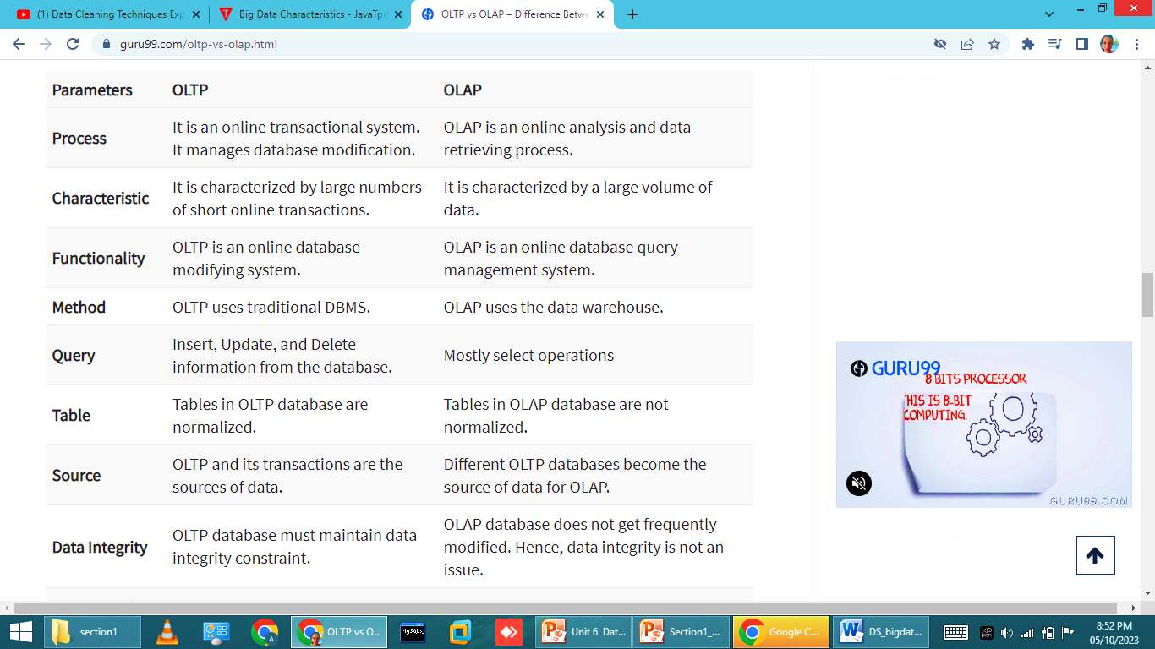

Slide 33
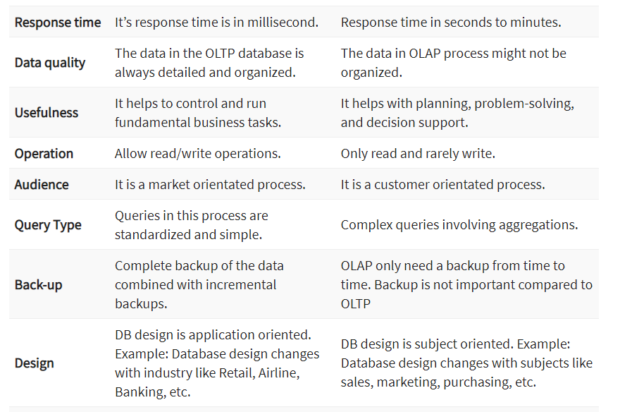

Slide 34
Big data
Big data is a term applied to data sets whose size or type is beyond the ability of traditional relational databases to capture, manage and process the data with low latency.
Big data is a combination of structured, semi structured and unstructured data collected by organizations that can be mined for information and used in machine learning projects, predictive modeling and other advanced analytics applications.
Big data sources : Social media, Mobile devices, Transactional data Networked devices , E-commerce site, stock exchange etc

Slide 35
Types of Big data
1. Structured
Structured data refers to the data that you can process, store, and retrieve in a fixed format.
2. Unstructured
Data with an unknown structure is termed unstructured data
3. Semi-structured
As the name suggests, semi-structured data contains a combination of structured and unstructured data.

Slide 36
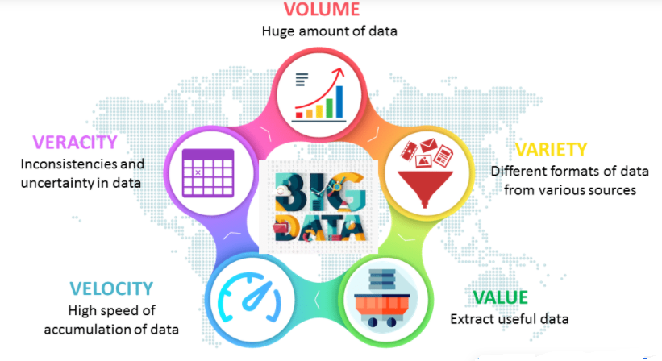
Characteristics of Big Data

Slide 37
Characteristics of Big Data
Volume : Volume refers to the amount of data that you have.
Velocity of data: Velocity refers to the speed with which data is generated.
Value :Value refers to the benefits that your organization derives from the data.
Variety :Variety refers to the different types of big data.
Veracity: Veracity refers to the accuracy of your data. Veracity means how much the data is reliable.
Volatility: It refers to how long the data is valid since the data which is valid right now might not be valid just a few minutes or fewer days later.

Slide 38
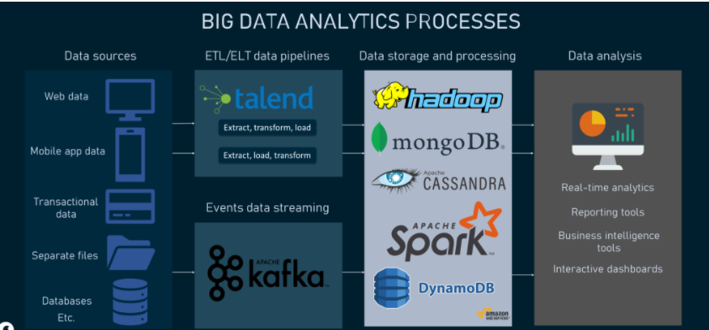

Slide 39
Data ingestion
The process of identifying the sources and then getting Big Data varies from company to company. Modern technologies allow gathering both structured (data that comes in tabular formats mostly) and unstructured data (all sorts of data formats) from an array of sources including websites, mobile applications, databases, flat files, customer relationship management systems (CRMs), IoT sensors, and so on.
Raw data must undergo the processes of extraction, transformation, and loading, so either ETL or ELT data pipelines are built to deliver data from sources to centralized repositories for further storage and processing. With the ETL approach, data transformation happens before it gets to a target repository like a data warehouse, whereas ELT makes it possible to transform data after it’s loaded into a target system.

Slide 40
Data storage and processing
Based on the complexity of data, it can be moved to the storages such as cloud data warehouses or data lakes from where business intelligence tools can access it when needed. Storage layers allow data coming from disparate sources to be arranged in partitions for further optimization and compression. Compute layers are the sets of processing engines used to perform any computational tasks on data.
When data is in place, it has to be converted into the most digestible forms to get actionable results on analytical queries. For that purpose, different data processing options exist. The choice of the right approach may depend on the computational and analytical tasks of a company as well as the resources available.
Based on the criteria of the use of one or several machines, processing environments are classified into centralized and distributed:
Centralized processing, as the name implies, has all the processing happening on one computer system (a dedicated server that hosts all data). So, multiple users share the same resources and data at the same time. Along with the single point of control comes a single point of failure. If anything goes wrong, the entire system fails, not just a part of it.
Distributed processing is used when datasets are just too vast to be processed on a single machine. Such an approach allows for breaking down large datasets into smaller pieces and storing them across multiple servers. This, in turn, makes it possible to process data in parallel. The great thing about the distributed approach is that data processing tasks can be moved to other available servers in case one server in the network crashes.

Slide 41
Data analysis
To make sense of the huge amounts of data, there are several techniques and practices. Below we list some of them:
Natural language processing is the technology used to make computers understand and respond to human language, whether it is text or spoken words.
Text mining is an advanced analytical approach used to make sense of Big Data that comes in textual forms such as emails, tweets, researches, and blog posts.
Sensor data analysis is the examination of the data that is continuously generated by different sensors installed on physical objects. When done timely and properly, it can help not only give a full picture of the equipment condition but also detect faulty behavior and predict failures.
Outlier analysis or anomaly detection is the technique used to identify data points and events that deviate from the rest of the data. It’s widely applied in fraud detection activities.

